Slide 1
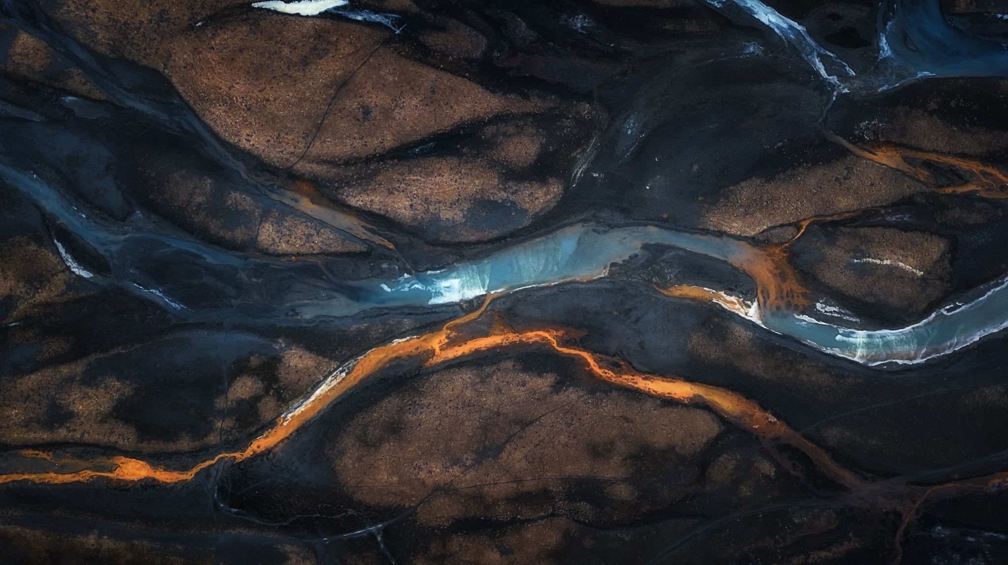
My WW1 presentation
Eva J Clementson

Slide 2
The attack
Even the rats took shelter under the soldier’s bed as many German grenades fell down on the trenches. Cries of ‘run’ and ‘protect your head’ rang out all down the front line. Many of the soldiers were slipping in the mud, falling and dying. Those who lived, hoped that their loved ones had not died in German raids back at home.
If not for the sudden attack, the soldiers would be writing letters to home, waiting for an attack, scratching the lice that had taken over their bodies, shooting the other trenches or mourning the death of their friends. It was not fun living in the trenches.

Slide 3
Waiting for destruction
The German raids were destroying life as people could remember, the new normal was having paint in their windows and lights off at 7:00 pm. Everyone was always expecting more Germans to come to destroy more buildings. That was the custom.
Despite the fact that ‘Dad’s army’ was trying to protect them, no-one felt safe. Many were helping Britain in other ways (not fighting). For example: many women became police officers, engineers and taxi drivers. Some women even went to be doctors on the front-line.

Slide 4
Dear Janet
This is the original letter…
Dear Janet,
I hope you are okay. The army is planning to invade the German trenches when we get back from Spain (we are currently travelling over the border).
My time in the trenches is almost done and I can’t wait to see you and the rest of the family.
So far, I really enjoyed when me and a few others went to a German trench and took it over! Now, we have spies in there!

Slide 5
Dear Janet
…and this is what the real letter would look like…
Dear Janet,
I hope you are okay. The army is planning to invade the German trenches when we get back from Spain (we are currently travelling over the border).
My time in the trenches is almost done and I can’t wait to see you and the rest of the family.
So far, I really enjoyed when me and a few others went to a German trench and took it over! Now, we have spies in there!

Slide 6
Another day
Dear Diary,
Today was another day that I lived. Only 25 soldiers came in today, 25 less than yesterday. I hope that by helping soldiers, I am helping the army finally defeat Germany.
It is sad to see the endless river of injured men, all fighting for Britain’s freedom, never to know if their lives were worth it.
I am a big fan of Wilfred Owen’s poetry, and I believe that it is NOT sweet or fitting to die for one’s country.

Slide 7
Wilfred Owen: Anthem for doomed youth
After reading Anthem for doomed youth, I realised what it must have been like to be a soldier in WW1.
From the poem, a bit that stood out for me was the first line, ‘What passing-bells for these who die as cattle?’ it means that the soldiers were dying all the time and everywhere and without mercy. It shows that they were being treated like animals, not humans.
Another line, ‘The shrill, demented choirs of wailing shells;’ also stood out for me. This is saying that the noise of the shells gave them dementia and was bad for their hearing. I find this sad.

Slide 8
Becoming a solider
This is what a draft form would have looked like…
NAME – Geoff Sandy
AGE – 19
HEIGHT – 5.5 foot
WEIGHT – 10 stone
HAIR COLOUR – brown
EYE COLOUR – brown
WHY THE ARMY – I want to protect my family and friends and be a part of history.

Slide 9
On the menu
potatoes
TEA
Beans
bread

Slide 10
Helping out
Children in WW1 helped out in the war, mostly by growing their own food like carrots and potatoes. They did this because of rationing. Rationing is when there is not enough food for everyone so there is an amount of food that a person can have each day.
Whilst the women took the men’s jobs and the men went to fight, the children were left to take up the women’s job’s. These included things like shopping, making and repairing clothes, looking after the animals and making dinner. Because of this, some say that the children were much more self-reliant and less lazy than children today.

Slide 11
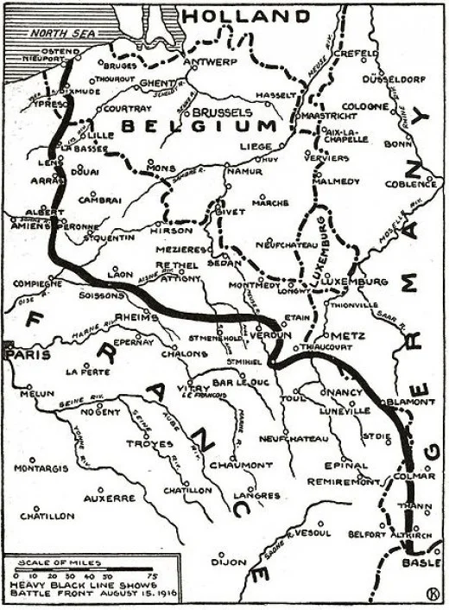
The Western Front
When you say ‘the front line’ what you’re actually saying is ‘The Western Front’. This is because ‘The Western Front’ is where all the fighting happened. It was in a western area (alas the name) from Britain but our trenches were just of the border, which was useful.
Here is a map of ‘The Western Front’ (the black line):

Slide 12
Weapons in the war
This is a list of the weapons they used in the war…
Grenades
Rocket Launchers
Machine Guns
Gas Attacks
Tanks + Airplanes
Snipers + Rifles
Pistols

Slide 13
Armistice day
After nearly 4 years of fighting, Britain was only too glad that the war was over. There were street-parties and celebrations everywhere you looked.
Many know Armistice day as Remembrance day: it is the same. We spend this day remembering those we’ve lost. We celebrate it on the 11th hour of the 11th day of the 11th month.
A two minute silence and poppies are the main things that people can remember the day by.

Slide 14
The End
I hope you enjoyed my presentation, I worked very hard on it.
Thank you for listening/reading my presentation.

